Slide 1
Information Gathering Tools cont.

Slide 2
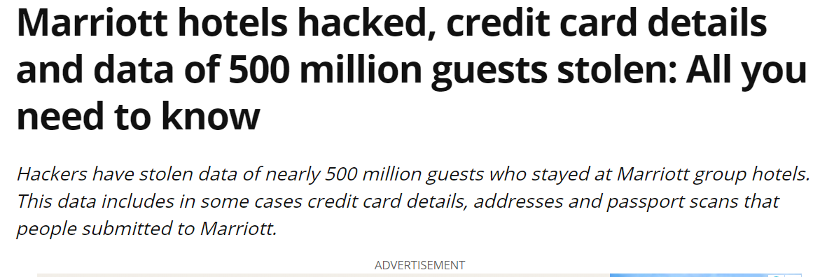
Case Study
JW Marriott site was hacked where information of credit cards were leaked (search)
https://www.indiatoday.in/technology/features/story/marriott-hotels-hacked-credit-card-details-and-data-of-500-million-guests-stolen-all-you-need-to-know-1400263-2018-12-01

Slide 3
Pastebin.com https://pastebin.com/
It leaked out Credit card info with CVV.
If you say OTP is required, internationally OTP’s are not required.
To break OTP is also not big task
https://pastebin.com/fcte4qNL
A pastebin is a Web application that allows users to upload and share text online. The most common use is for sharing source code or configuration information. There are thousands of pastebins online, often geared towards particular groups or focuses. Once text has been uploaded to a pastebin, other users can edit.
It seems to be frequently used as a public repository of stolen information, such as network configuration details and authentication records.
Notes:
Pastebin.com is a pastebin website. It was created in 2002 by Paul Dixon, and reached 1 million active pastes (excluding spam and expired pastes) eight years later, in 2010

Slide 4
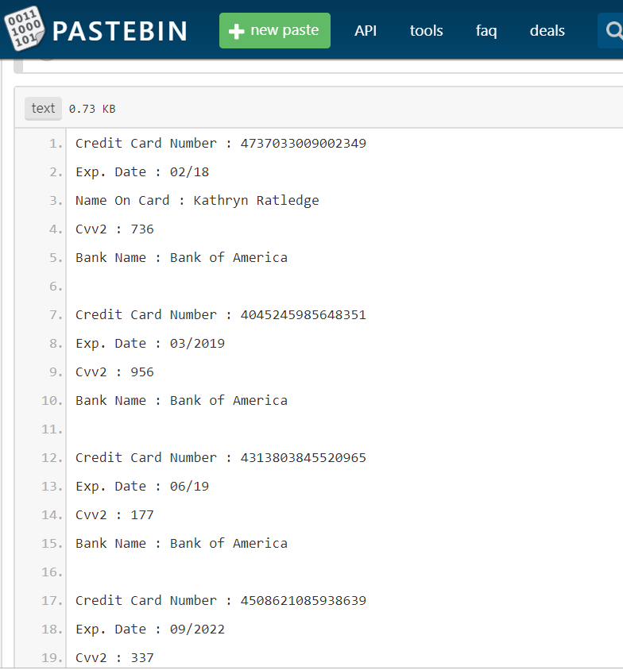
Why is Pastebin blocked?
Pastebin was blocked because the BTK, Turkey's Information and Communication Technologies Authority was hacked by famous hacker community Anonymous and information obtained from the agency was dumped to Pastebin.

Slide 5
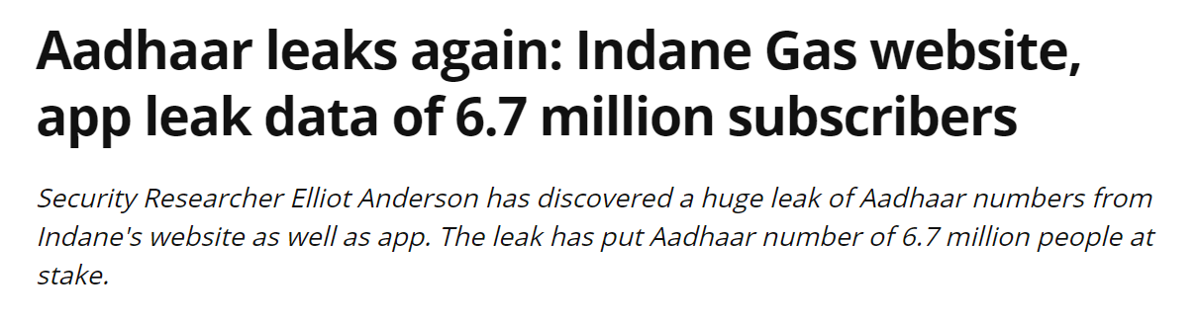
Case Study
LPG gas
Indane 7 million aadhaar cards breached (search)
It gave details of 7 million people passbook 1st page
https://www.indiatoday.in/technology/news/story/aadhaar-leaks-again-indane-gas-website-app-leak-data-of-6-7-million-subscribers-1459499-2019-02-19

Slide 6
Tool 10,11,12

Slide 7

Haveibeenpwned.com
Have I Been Pwned?- is a website that allows Internet users to check whether their personal data has been compromised by data breaches.
Personal data has been compromised by data breaches.
Collects and analyzes hundreds of database dumps of billions of leaked accounts.
Allows users to search for their own information by entering their username or email address.
Users can also sign up to be notified if their email address appears in future dumps.

Slide 8
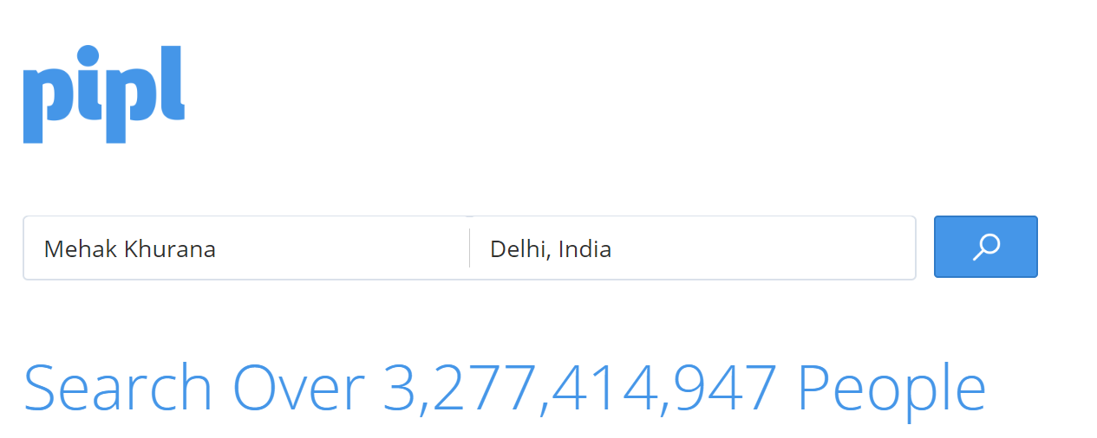
Pipl.com
It asks for name and location of the person,
it will the details of the people having the same name in that location
https://pipl.com/

Slide 9
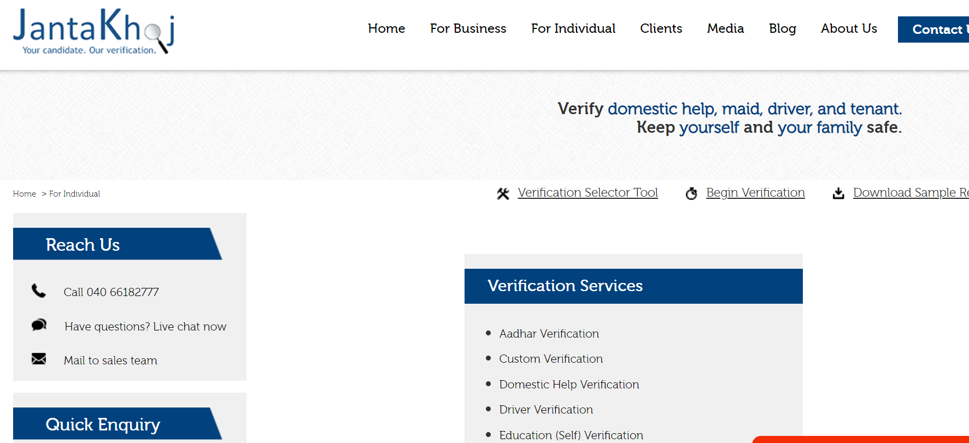
Jantakhoj.com
Democratize the background verification process and bring it within easy reach of every individual.
Promote greater transparency in society
It gives details related to
verification,
police record,
photo,
location etc.
Used for investigation purpose (tehquikat)

Slide 10

How many websites we need to search to find the information?
Solution:
OSINT Framework- Open source Intelligence tracking
It is BIBLE for cyber cell (GRANTH)
All the information is available on it

Slide 11
OISNT Framework
Tons of public resources contains plenty of information spreaded across the internet.
That’s why the OSINT Framework plays such an important role
Collection of OSINT tools to ease data collection.
Used for
Digital footprinting,
OSINT research,
intelligence gathering, and
reconnaissance.
It provides a simple web-based interface

Slide 12
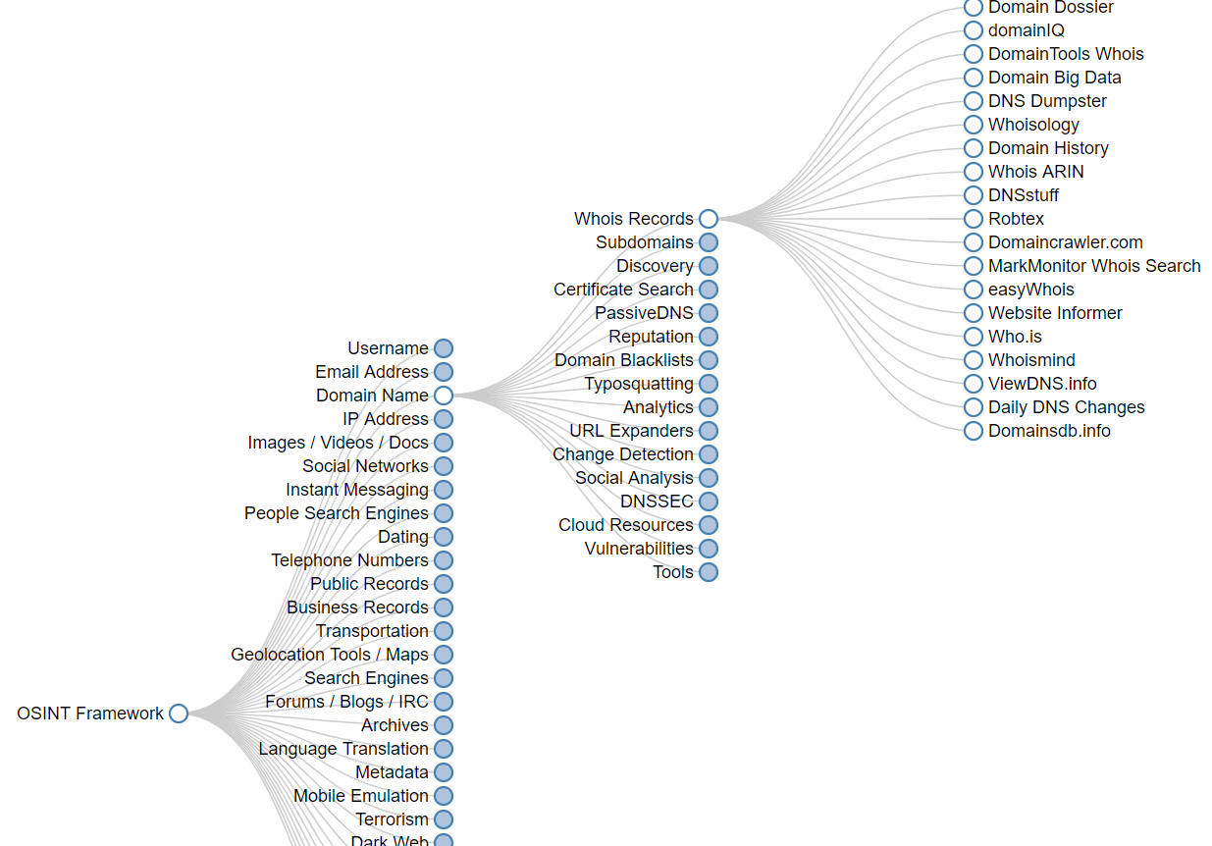
OSINT Framework
Its shows tree like structure
https://osintframework.com/

Slide 13
Kali Linux Tool 13

Slide 14
Maltego Tool- Patvera
Open Source Intelligence or forensic tool
US Based Tool
Used in online investigations for finding relationships between pieces of information from various sources of the Internet.
Patvera company (Patvera.com)

Slide 15
DEMO

Slide 16
Kali Linux Tool 14

Slide 17
Harvester
Tool
Harvester
It is pre-installed in Kali Linux
Gathering Emails that belongs to specific company/organisation
E.g. Lets Hack website bbc.com to get emails of employees
bulk emails can be used to send malicious link
advantageous for hacking purpose

Slide 18
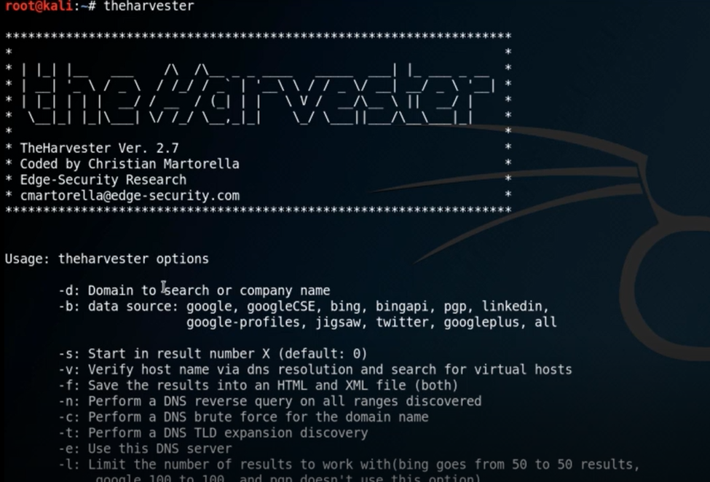
Harvester-Demo
Command :
Theharvester
->gives many options

Slide 19
Harvester
Options
-d
-b
-l
-h
Example
theharvester –d microsoft.com –l 500 –b google
Limit is set to 100 (find only 100 addresses)
for finding domain
data sources- google, linkedin, twitter etc, all
limit the no. of results
SHODAN database
it is a big advanced search engine that search database

Slide 20
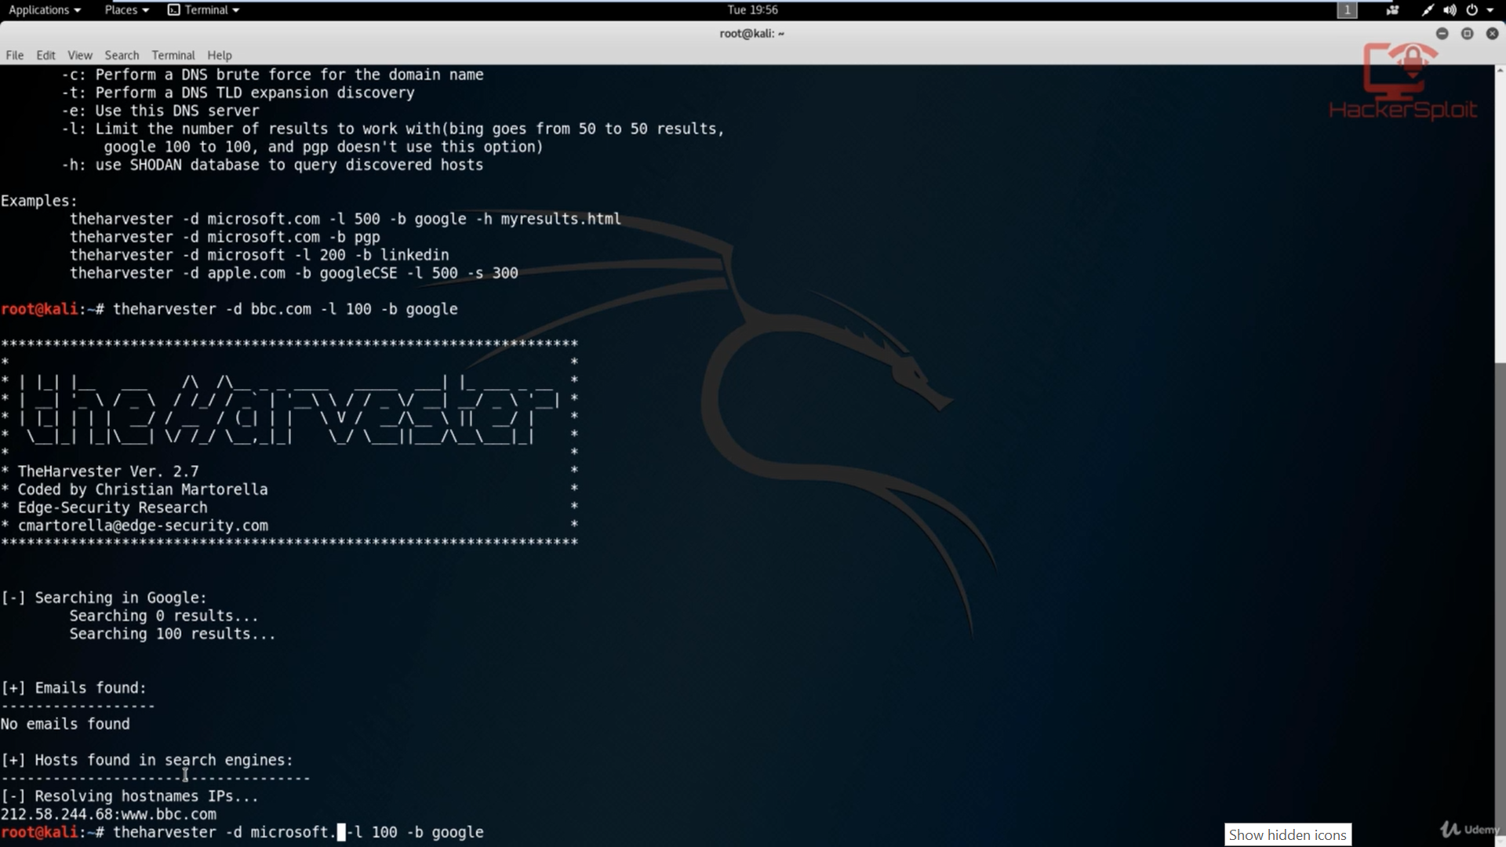
Harvester
theharvester –d bbc.com –l 500 –b google
It is not showing emails
Notes:
Try www.ijph.in

Slide 21
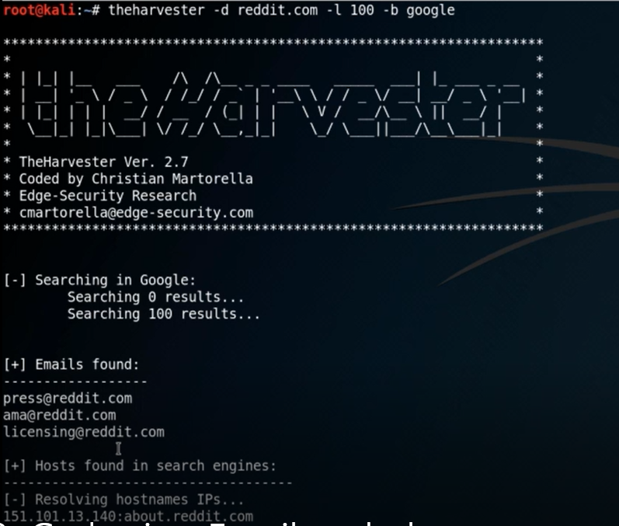
Harvester
theharvester –d Reddit.com –l 500 –b google
It shows emails
Shows hosts

Slide 22
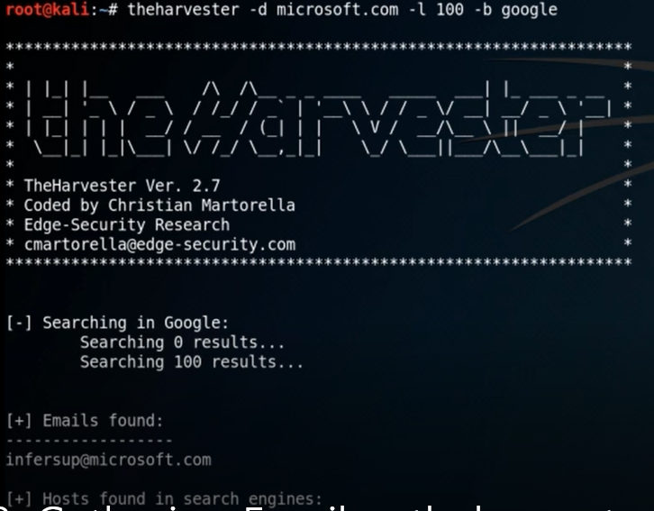
Harvester
So we can try with some other website
theharvester –d microsoft.com –l 500 –b google
It shows one email id
We have also get hosts/subdomains with different IP addresses, which will be helpful

Slide 23
Harvester- Task
theharvester –d ncuindia.edu –l 500 –b google
Find emails
Find Hosts

Slide 24
Tool 15

Slide 25
DNS Enumeration: NSLOOKUP
Nslookup is a network administration tool for querying the Domain Name System (DNS) to obtain
Domain name or
IP address mapping or
any other specific DNS record.
Nslookup can operate on both “Interactive mode” and “Non-Interactive mode”.
Interactive mode -allows the user to query the DNS-Server about various host, and domains.
Non-Interactive mode -allows the user to query the information for a host or domain.

Slide 26
DNS Enumeration: NSLOOKUP
>nslookup microsoft.com
Server: 8.8.8.8
Address: 8.8.8.8#53
Non-authoritative answer:
Name: microsoft.com
Address: 134.170.185.46
Name: microsoft.com
Address: 134.170.188.221
8.8.8.8 is the address of our system’s DNS.
"#53" is the standard port number domain name servers use to accept queries.
Microsoft.com uses a round robin setup to distribute server load.
It is server our system is configured to translate domain into IP
Returned two entries, 134.170.185.46 and 134.170.188.221.

Slide 27
NSLookup commands
NS lookup
mx
ns
soa
any
A
AAAA
debug

Slide 28
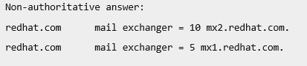
E.g. Different usage of nslookup
Query the MX Record using -query=mx: MX ( Mail Exchange ) record maps a domain name to a list of mail exchange servers for that domain.
The MX record tells that all the mails sent to “@redhat.com” should be routed to the Mail server in that domain.
Example: nslookup -query=mx redhat.com
mail exchanger address is prefixed with a number (10) and (5).
the lower numbers representing a higher priority.

Slide 29
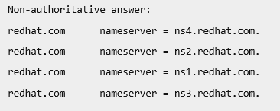
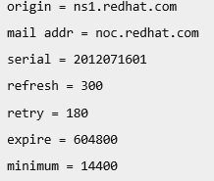
E.g. Different usage of nslookup
Query the NS Record using -query=ns: NS ( Name Server ) record maps a domain name to a list of DNS servers authoritative for that domain. It will output the name serves which are associated with the given domain.
Example: nslookup -type=ns redhat.com
Query the SOA Record using -query=soa: SOA record ( state of authority ), provides the authoritative information about the domain, the e-mail address of the domain admin, the domain serial number, etc…

Slide 30
Kali Linux Tool 16

Slide 31
Domain information groper (Dig)
dig is a network administration command-line tool for querying Domain Name System (DNS) servers.
Is useful for network troubleshooting and for educational purposes.
Similar options as of NSLookup-MX, NS, SOA, AAAA, A
Inbuilt tool of Kali Linux
E.g. dig NS google.com
search went from ns2->ns1->ns4->ns3, that means name server 2 have more preference over name server 1

Slide 32
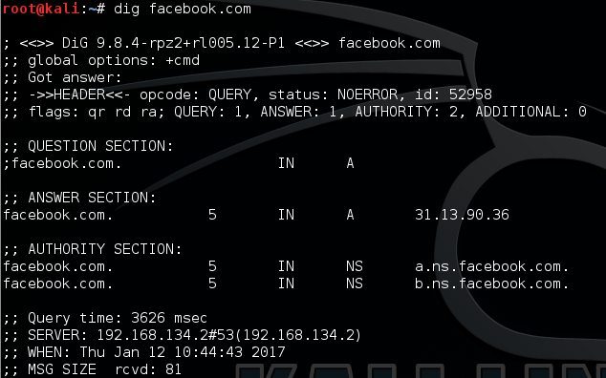
Dig
Open innmong Section
Dig google.com NS ---- Find all name server
Dig google.com MX---- Find all mail server
Dig google.com A ---- Resolve domain name to IP addresses
Dig google.com AAAA– give IPV6 address

Slide 33
Tool 17,18

Slide 34
Netstat
Netstat command
Displays
Active TCP connections
Routing table
Interfaces information.
Used for
finding problems in the network and
Determine the amount of traffic on the network as a performance measurement.
displays very detailed information about how your computer is communicating with other computers or network devices.
Local IP address (your computer)
Foreign IP address (the other computer or network device)
Respective port numbers,
TCP state

Slide 35
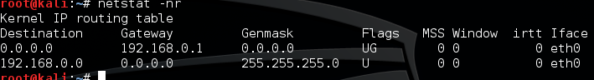
netstat command
netstat is a useful tool for checking network configuration and activity. It is a command line network utility that display TCP connections, routing table and interfaces information. It is used for finding problems in the network and to determine the amount of traffic on the network as a performance measurement.
#netstat –nr: Displays the Kernel’s Routing Table
The fourth column displays the following flags that describe the route:
G: The route uses a gateway.
U: The interface to be used is up.
H: Only a single host can be reached through the route.
D: This route is dynamically created.
M: This route is set if the table entry was modified by an ICMP redirect message.
The MSS (Maximum Segment Size): the size of the largest datagram the kernel will construct for transmission via this route.
The Window: the maximum amount of data the system will accept in a single burst from a remote host.
irtt : “initial round trip time.”

Slide 36
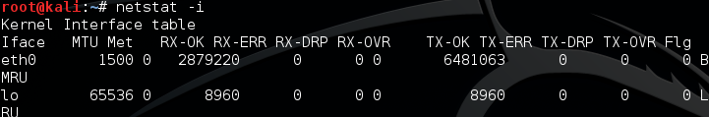
#netstat –i: displays kernel’s interface table
The MTU and Met fields: show the current MTU and metric values for that interface.
The RX and TX columns: show how many packets have been received or transmitted error-free (RX-OK/TX-OK) or damaged (RX-ERR/TX-ERR); how many were dropped (RX-DRP/TX-DRP); and how many were lost because of an overrun (RX-OVR/TX-OVR).
For More options check
http://www.thegeekstuff.com/2010/03/netstat-command-examples/

Slide 37
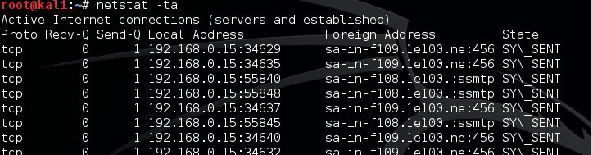
#netstat –ta: displays list of all servers that are currently running on your system.
The options –t, –u, –w, and –x show active TCP, UDP, RAW, or Unix socket connections.
–a flag in addition, sockets that are waiting for a connection (i.e., listening) are displayed as well.

Slide 38
Trace route
Trace route is a computer network diagnostic tool for
Displaying the route (path) and
measuring transit delays of packets across an Internet Protocol (IP) network.
Route is recorded as the round-trip times of the packets received from each successive host (remote node) in the route (path);
Sum of the mean times in each hop is a measure of the total time spent to establish the connection.
Trace route proceeds unless all (three) sent packets are lost more than twice, then the connection is lost and the route cannot be evaluated.
Trace route Vs. Ping
Ping only computes the final round-trip times from the destination point.

Slide 39
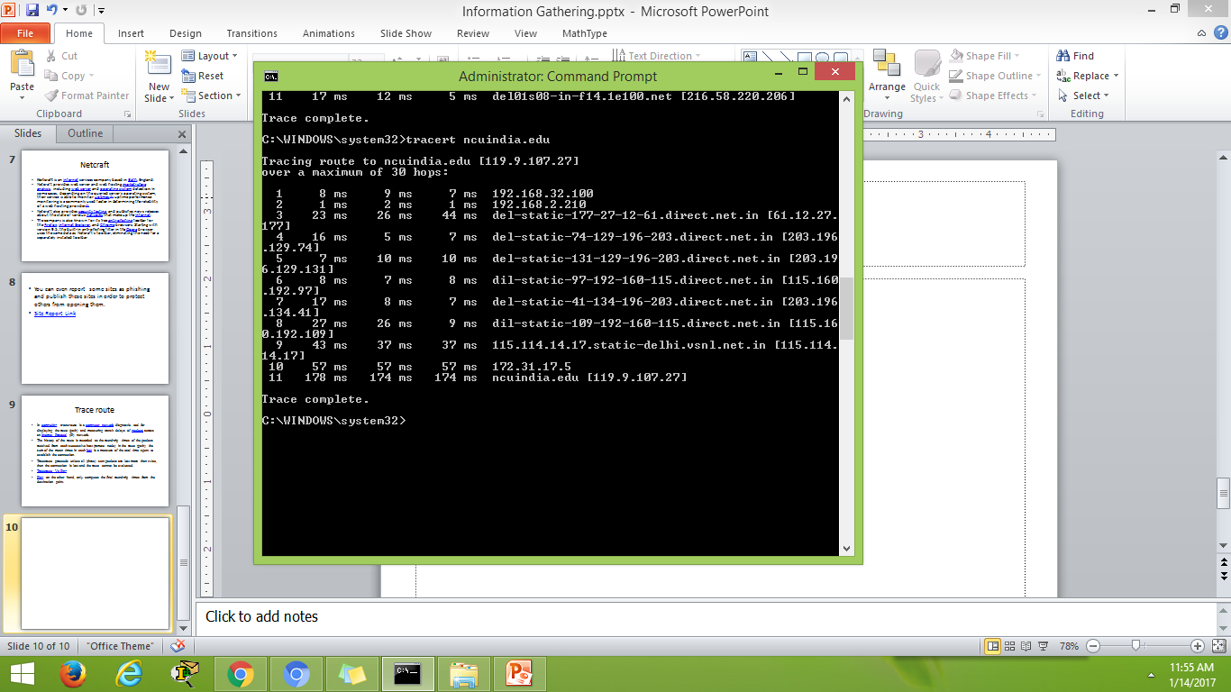
Trace Route- tracert

Slide 40
DRILL
Select
Select one Website
Use
Use the above tools to find all the relevant information of selected website
Prepare
Prepare a report

